Slide 1

ModelIt!
Student Lesson
Can You Outsmart a Disaster?
How Science Helps Communities Survive Natural Hazards
NGSS: MS-ESS3-2
6th Grade
1/9

Slide 2
What You Will Learn Today
Learning Goals
* Analyze data patterns to predict where natural hazards are most likely to occur
* Model how hazard intensity, population density, warning time, and building design interact to determine disaster outcomes
* Evaluate engineering solutions that reduce the impact of natural hazards on communities
* Use model evidence to design a disaster-resilient community plan
Key Vocabulary
Natural Hazard
A natural event (earthquake, flood, hurricane, wildfire) that threatens human life and property
Resilience
A community's ability to prepare for, withstand, and recover from natural hazards
Mitigation
Actions taken BEFORE a disaster to reduce its impact — building codes, levees, firebreaks
Early Warning System
Technology that detects hazards in advance, giving people time to prepare or evacuate
2/9

Slide 3

The Big Question
Why do some communities survive natural disasters better than others — what makes the difference between tragedy and resilience?
How Science Helps Communities Survive Natural Hazards. Today we'll build a MODEL to discover the answer!
3/9

Slide 4

Today We Will Build a Model!
A model helps us understand complex systems!
1. LOCATE
Identify the COMPONENTS (parts) of the system
2. ESTABLISH
Connect them with RELATIONSHIPS (+ or -)
3. VISUALIZE
Build your model in ModelIt!
4. EVALUATE
Run SIMULATIONS to test scenarios
5. REVISE
Improve your model based on evidence
4/9

Slide 5
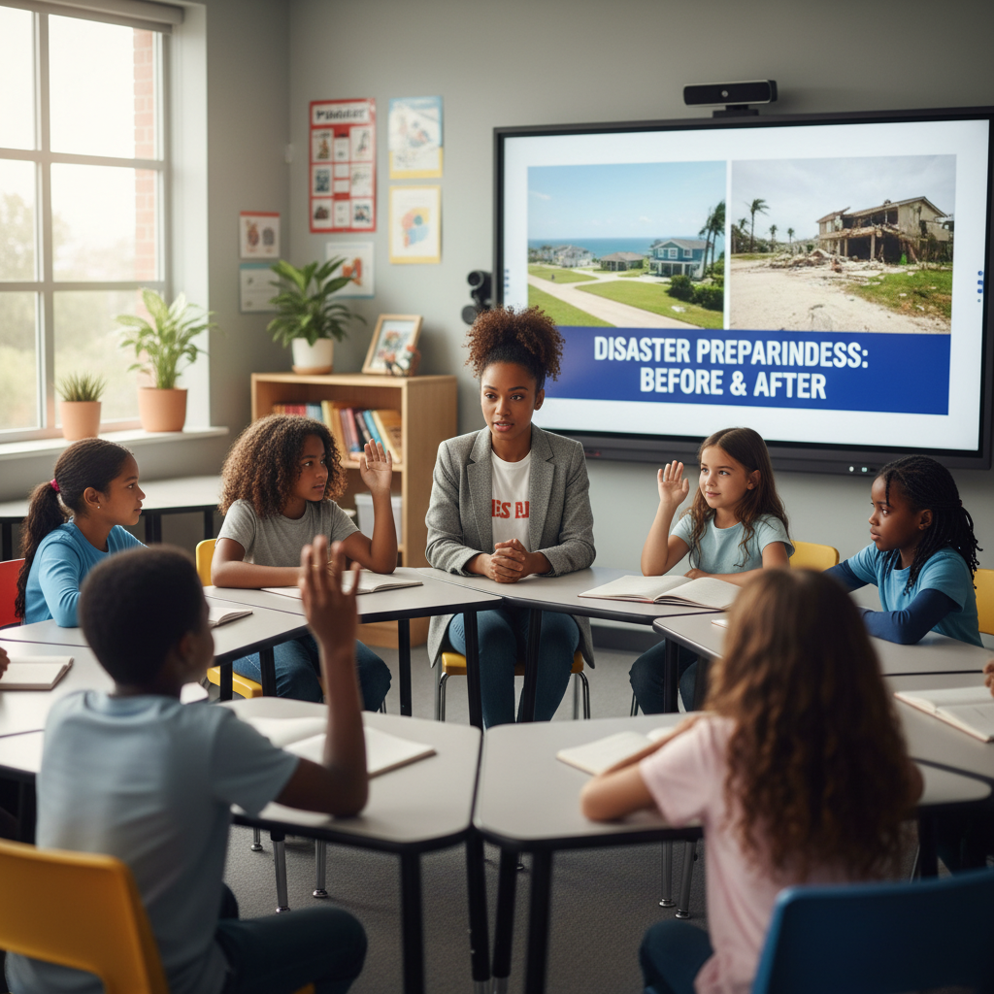
Activity 1: Sort the Components
Sort these components into EXTERNAL (inputs from outside) and INTERNAL (inside the system):
Your Components:
* Hazard Intensity
* Population Density
* Warning Time
* Building Design
Think: Which components can we control? Which happen on their own?
5/9

Slide 6
Activity 2: Connect with Arrows
Draw arrows to show HOW components affect each other:
(+) POSITIVE Relationship
When one goes UP, the other goes UP too
(-) NEGATIVE Relationship
When one goes UP, the other goes DOWN
Think About It:
When warning time increases, what happens to the number of casualties? Does better building design help more against earthquakes or floods?
6/9

Slide 7
Activity 3: Run the Simulation!
Test these scenarios in ModelIt!
Unprepared City
Set Building Design to 10% and Warning Time to zero — observe the outcome
Prepared Community
Set Building Design to 80% and Warning Time to 48 hours — compare to unprepared
Monster Storm
Lock Hazard Intensity to maximum — can ANY preparation save everyone?
Watch the activity graphs change!
[ModelIt Platform Screenshot - Simulation Results Graph]
7/9

Slide 8
What Did We Discover?
Our Model Showed Us:
* Warning time dramatically reduces casualties but NOT property damage — you can evacuate people but not buildings
* Building design is the most effective factor for reducing BOTH casualties and property damage
* Population density multiplies the impact — the same earthquake in a rural area vs. a dense city produces vastly different outcomes
* No amount of preparation can eliminate all risk from extreme natural hazards — but it can reduce impact by 80-90%
Answer: The difference between communities that survive disasters and those that don't comes down to three things: early warning systems (to evacuate), building codes (to withstand the hazard), and planning (to reduce population in high-risk zones). Japan and Haiti both get earthquakes, but Japan's preparation results in far fewer deaths because of decades of investment in resilient engineering and warning systems.
8/9

Slide 9

STEM Challenge: Design a Disaster-Resilient Community
YOUR ENGINEERING MISSION
Design a community plan for a region that faces multiple natural hazards (earthquakes AND flooding) that minimizes casualties and property damage within a limited budget.
The Challenge:
A coastal city near a fault line needs a comprehensive disaster resilience plan. Your urban planning team has a $10 million budget and must decide how to allocate resources among warning systems, building upgrades, evacuation routes, and emergency shelters. Use your model evidence to justify every budget decision.
Think Like an Engineer:
* Based on your model, which investment saves the most lives: warning systems, building codes, or evacuation routes?
* How do you prioritize when the city faces BOTH earthquake and flood risk?
* What compromises must you make with a limited budget?
REAL CAREER CONNECTION: Emergency Management Specialists and Civil Engineers design systems that protect communities from natural hazards. They plan evacuations, design resilient infrastructure, and save lives. They earn $60,000–$120,000/year. The skills you're using TODAY are the same ones they use on the job!
9/9

